Slide 1
LA City Homeless
A laboratory analysis
Group 16
Jue Song
Zhuoqun SHENG
Xudong ZHANG

Slide 2
Content
Data Preparation
Data Analysis & Visualization
Next Step

Slide 3
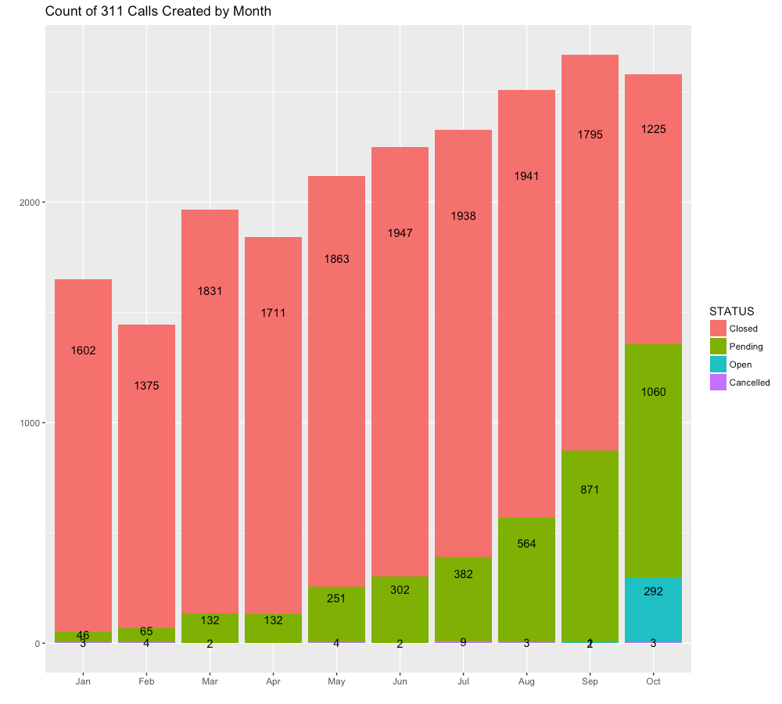
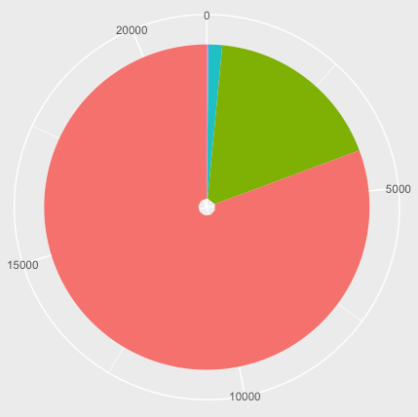
21358 calls requesting HOMELESS ENCAMPMENT
Status(Pending/Closed)
ServiceDate

Slide 4
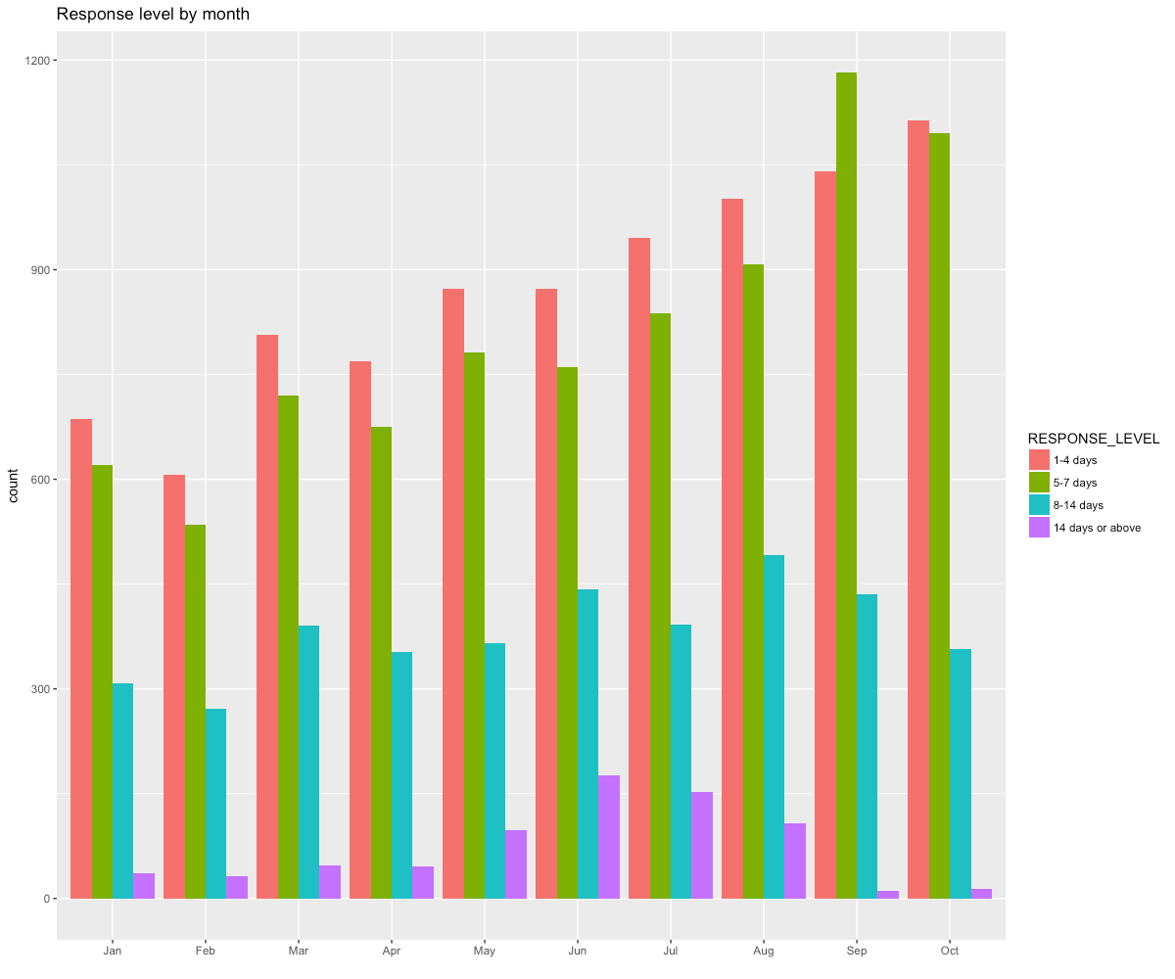

Slide 5
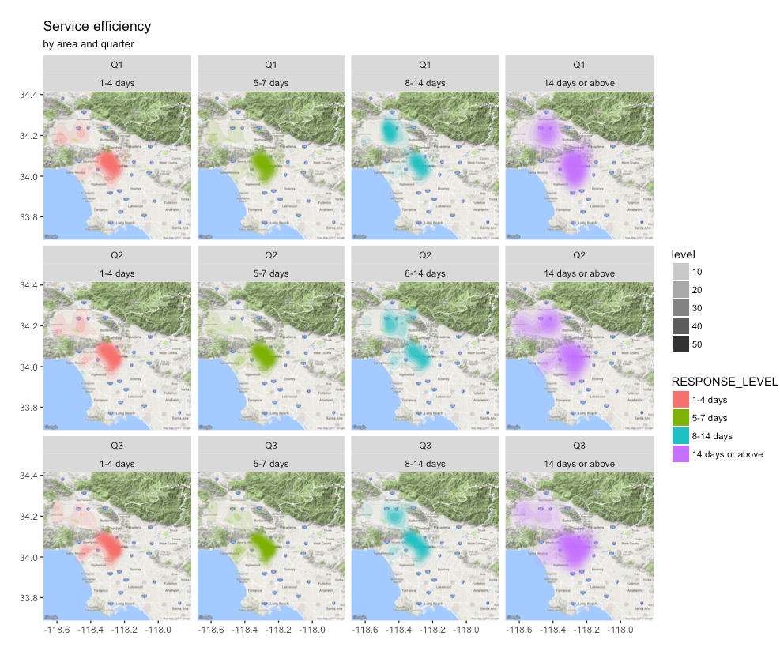

Slide 6
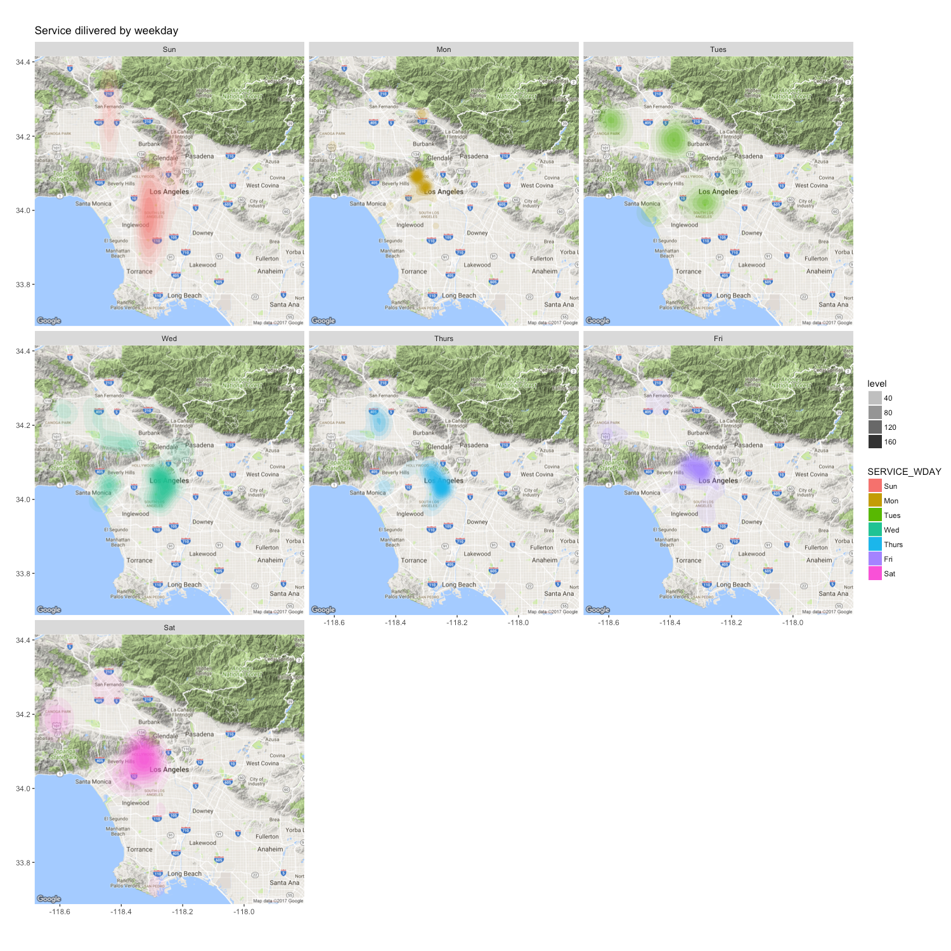

Slide 7
Thank you !

